Slide 1
Smart Control Systems

Slide 2
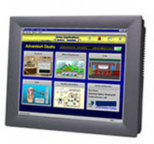
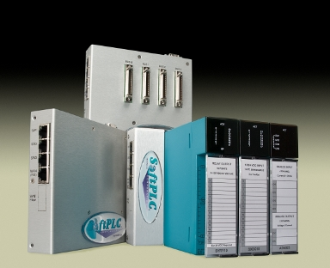
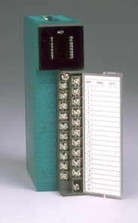
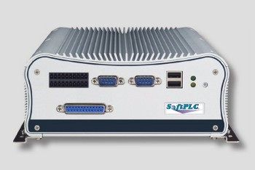
Product line overview

Slide 3
SoftPLC®
SoftPLC Programmable Automation Controllers (PAC’s)
Functionality of PLC’s, RTU’s and DCS controllers combined with data/computation functions of computers
All models include same features/functions and use same programming/maintenance software
Models differ in hardware only (e.g.: ports, memory, speed)
SoftPLC Gateways (Protocol Converters)
Any SoftPLC can be a Gateway
Higher performance/more features than other gateway products

Slide 4
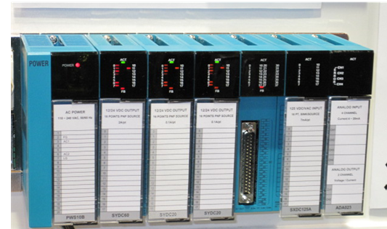
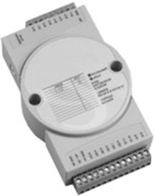
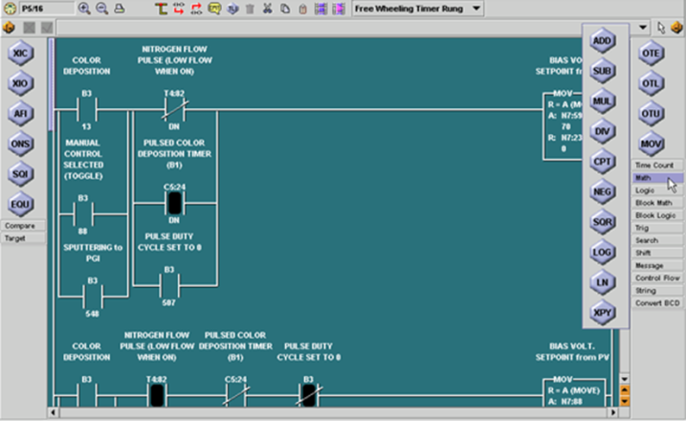
SoftPLC
Industrial I/O
Tealware™ - Modular rack-mounted I/O system, local & Ethernet configurations
A-Series – Low count/low cost serial & Ethernet I/O
Interface cards for industrial networks (e.g.: Profibus, DeviceNet)
TOPDOC® – SoftPLC Programming Software
Configuration, application development, troubleshooting
Available for Windows & Linux

Slide 5
TagWell™
Open platform for cloud-based remote asset management
Monitor/Acquire data from remote systems
Write to remote systems to change operating parameters, acknowledge alarms
Email/Text alerts
User designed web page interfaces

Slide 6
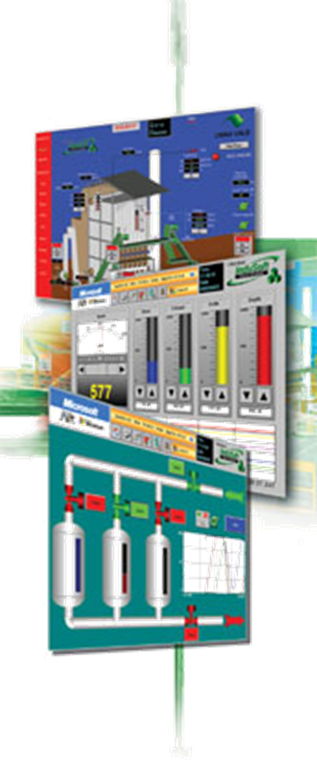
SoftPLC Web Studio
Web Studio is a complete SCADA software product
All features included, no add-on costs
Runs on any Windows environment, including mobile devices up to redundant servers
Web Studio HMI’s are Panel-PC’s w/ Web Studio runtime pre-loaded
3.5” - 17” sizes available in standard models
Custom sizes/specification models also available (e.g.: hazardous/marine area, other mounting options, etc.)

Slide 7
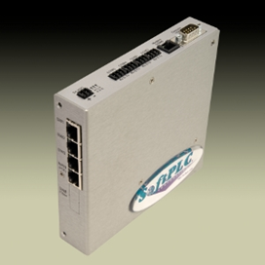
Communication Products
Gatecraft Industrial Ethernet Products
Switches/Routers
Media converters
Remote Access Modems
Wireless Interfaces
Firewalls/VPN’s
Remote Serial Servers
Smart Netbox
Gatecraft Shield Firewall

Slide 8
Company overview
1983
1985
1988
1993
1996
2001
2007
2009
2011
Tele-Denken
formed
TOPDOC
SoftPLC PACs
Name change
to SoftPLC
Tealware I/O
Linux Version
SoftPLC
Web Studio
SCADA/HMI
SmartBoard
Micro-RTUs
TagWell

Slide 9
History – Key Events
Founded in 1983 as Tele-Denken Resources, Inc.
By ex-Allen-Bradley employees
Privately held, Texas Corporation
US classified as small, woman-owned business
1980’s
Drivers and open toolkit API for PLC networks to PCs (O•N•E)
A-B PLC programming software (TOPDOC®)
for PLC/PLC-2, PLC-3, PLC-5
A-B private-labeled TOPDOC PLC-3 as 6200 software
A-B PLC emulation software (SoftWIRES™)

Slide 10
History – Key Events
1990’s
SoftPLC Programmable Automation Controllers
Tealware I/O
Changed company name to SoftPLC Corporation
2000’s
Gatecraft™ Linux O/S and Ethernet products
SmartBoard® & Smart product family
SoftPLC Web Studio
SoftPLC Micro RTUs
TagWell™

Slide 11
Corporate Strengths
Inventors & Innovators
Many industry first software features/functions
Embrace & provide open architecture technologies
Apply computer technologies to industrial automation market
Focused market offering – specialize in industrial automation products
Experts in embedded software (e.g.: I/O drivers, networking, operating systems)
Reliability & Determinism comes first
Treasure customer feedback
React quickly to customer requests

Slide 12
Corporate Strengths
Excel in customer support services
No “case numbers”
Support staff are field experienced application engineers
“I can’t remember a time in the last 20 years that a vendor went to the lengths that SoftPLC Corp. did to ensure our projects were a success.” (US Army Corps of Engineers)
Worldwide network of technical distributors & system integrators for local support
24-7/365 support available

Slide 13
Customers
SoftPLC Customers can be found in a wide variety of industries world-wide
Wood/Paper – Boise Cascade, Weyerhaeuser, Int’l Paper, Bowater...
Food/Beverage –Safeway, Kraft, Pacific Shrimp, TeePak, Coca-Cola…
Transportation – Ford, Detroit Diesel, GM, Schenck, Lockheed, Toyota…
Quarries/Materials – Tilcon, LaFarge, Smurfit, Cadman…
Power – USBR, Detroit Edison, Dracena, NW Natural Gas, SCADA Solns…
Water – Ebasco, Taiwan Water, Miami-Dade County, City of Diamond IL…
Pharma/Semi-Con – Quest Labs, Bayer, 3M, Panasonic, ThermoBiostar…
PetroChem – BP, GE Plastics, China Petroleum, Shell, Dresser, Formosa…
Metals –ArcelorMittal, Alcoa, Valesul Aluminum, Midwest Metals…
and many more!

Slide 14
Project Story
1996-ongoing: US Army Corps of Engineers
Selected SoftPLC to replace old DCS system for hydroelectric controls after intense evaluation of controllers & I/O products
Currently >300 PLC's for unit controls, fish mgmt, navigation locks…
Each program ~10K rungs of logic, some have over 100K rungs
Due to project success, SoftPLC was selected in 2009 for Grand Coulee Dam upgrade by US Bureau of Reclamation
Largest power plant in the USA, 3rd largest in world (7GW)
Also pumps water to irrigate eastern half of Washington state
Using SoftPLC Web Studio HMI’s on this project too
Combined, SoftPLC is used to generate over 5% of US power and 19% of US Hydropower

Slide 15
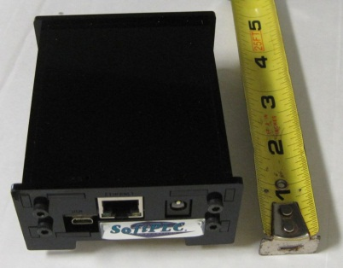
SoftPLC PAC’s
Features/Functions

Slide 16
“What is a SoftPLC?”
SoftPLC is control software that turns an embedded computer into an open architecture PAC
First “PAC” (Programmable Automation Controller) on the market
Embedded software, runs on dedicated “headless” systems (eg: no monitor, keyboard…)
Provides features of proprietary PLC’s (I/O control, PID) PLUS features of computers (flexibility, networking, speed)
Programming/Addressing modelled after A-B PLC’s
A-B PLC “on steroids”
A-B users need no training and have an easy, affordable upgrade path to a modern, feature-rich, low-cost solution

Slide 17
“What is a SoftPLC?”
SoftPLC’s are not PLC’s
Better communications and data handling
Advanced features – even beyond proprietary PAC’s
Truly open architecture
SoftPLC’s are not PC-based controllers
Deterministic scan (“hard” realtime)
Online run-mode program changes
Troubleshooting tools like PLC (Runtime Fault detection, I/O Forcing)
Runs on embedded Linux, no Windows
All SoftPLC’s have same firmware – only hardware differs from model to model (eg: # of ports, memory, CPU speed)

Slide 18
SoftPLC PACs
Hardware Models

Slide 19
SoftPLC’s SmartBoard®
All SoftPLC “Smart” products are based on the SmartBoard® design
Rugged, compact, low-cost and powerful platform
Extensive communication options for Gateway applications
Low power requirements (2-5W based on options)
SmartBoard includes “hooks” for easy customization for OEM applications
Metal enclosure, DIN-rail or panel mount
Compact size (146.1 x 152.4 x 38.1 mm)

Slide 20
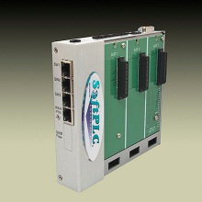
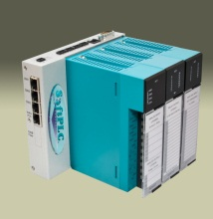
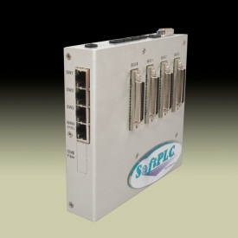
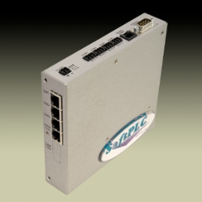
Smart SoftPLC I/O Interfaces
Selectable I/O interfaces
Local Tealware Interfaces
Backplane3 supports any 3 modules directly mounted on CPU
LocalPorts supports up to 12 Tealware racks, up to 30’ from CPU
Remote I/O
Ethernet (e.g.: ModbusTCP)
Serial (e.g.: Modbus)
A-B RIO
Bus I/O via PCI-104 interfaces (e.g.: Profibus, DeviceNet)
Supports up to 3 interface cards

Slide 21
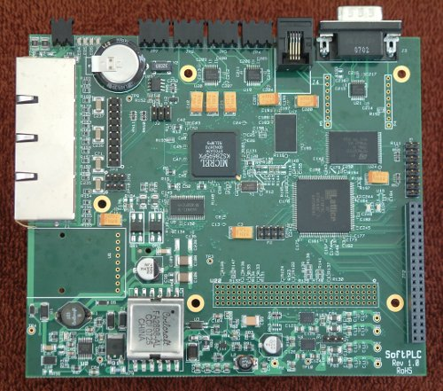
SmartBoard Internals
COM 5
RS-485
(or A-B RIO)
}
COM 1
(RS-232)
14~48VDC Power
COM 2-4
RS-232
COM 6
Phone Modem,
RS/485, or other
serial to RJ-11 (eg: A-B RIO)
3.3V
}
Enet 1
LAN
SuperCap
~60 days battery-free RTC power
63MB
SDRAM
10/100MB ManagedEthernet Switch
Enet 2
LAN
20 pin
JTAG
4MB
Boot Flash
Enet 3
LAN
166MHz ARM9 CPU
}
(5) GPIO
(3) FPGA I/O
WAN (PoE)
FPGA
}
SPI & 3.3V
(2) LED's tied to FPGA
PCI-104
Bus Interface
(32) lines
FPGA I/O (3.3V)
+3.3 & 5V power
Fiber Connector
(optional)
25W sourcing P/S (12W in PoE mode)

Slide 22
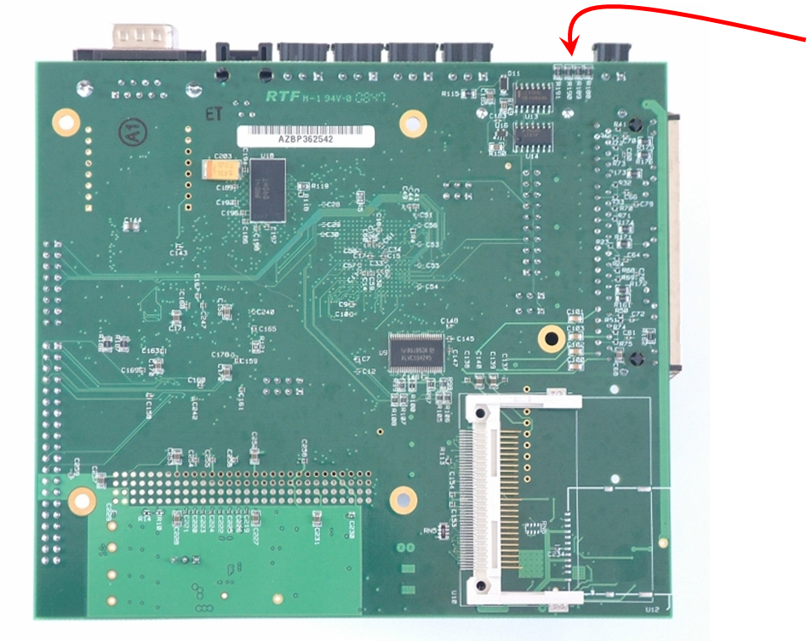
SmartBoard Internals
149.09mm
(4) LED's for system control indication
133.35mm
}
Compact Flash Interface (8 GBytes)
(future) SD Flash

Slide 23
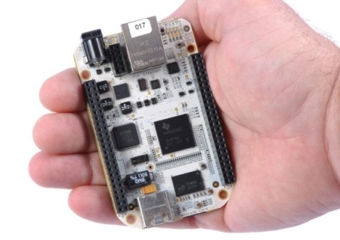
SoftPLC Micro RTUs
Very low power (<1W), ideal for battery/solar installations
Small physical size
Available w/ enclosure or as board-level product
Local and remote USB or ModbusTCP I/O options
Ethernet and USB ports
Add-on option for RS-232/-485 ports (eg: Modbus)

Slide 24
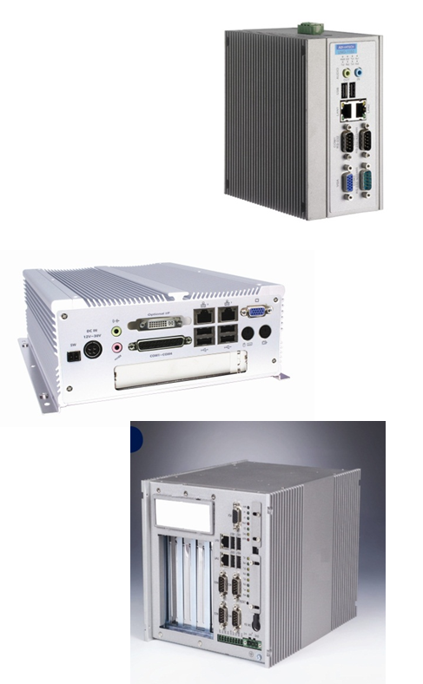
Hardbook Products
Powerful, stand-alone CPU’s for very large/specialty applications
Fanless, diskless
Multiple Ethernet, serial, USB ports
Up to 2GB RAM
Some models have PCI slot(s) for add-in cards
Range of standard models
Custom versions available based on application requirements (ie: slots, form factor, communication ports, environmental)

Slide 25
SoftPLC PAC’s
Firmware Features/Functions

Slide 26
User Memory
Data Table Registers
10K files of 10K elements each (100M words)
Addressing similar to A-B PLC-5/SLC-500
Binary, integer, floating point, PID, strings
Timer, counter, arrays, more
Status file for fault analysis, RTC, etc.
Every bit accessible by address or tag
Non-sequential display feature (Watch Window)

Slide 27
User Logic
Powerful Ladder Logic instruction set
Over 135 standard functions
Relay logic, timer/counter, math, data, PID, strings, more
Similar to PLC-5/SLC-500 programming
Program by address or tag
Up to 10K subroutines of 10K rungs each
All logic documentation stored in SoftPLC

Slide 28
User Logic
TOPDOC Loadable Modules (TLM’s) extend instruction set
Created in C⁺⁺ using toolkit, by SoftPLC Corp or customers
Can be ladder instructions, drivers, or program tasks
Examples
Calculations (Fourier transforms, cavitation, AGA gas flow)
Device Interfaces (motion controller, I/O devices, PC cards)
Encapsulate proprietary logic in a function block
Read/write to database
Print reports/Write files to remote disk

Slide 29
User Logic
Some SoftPLC provided TLM’s:
COMGENIUS – ASCII / Serial Communications
Drives, bar code/RFID, weigh scales, process equipment
Simple Modbus Master communications
Log Data – Event Logging
Log to CSV, binary, or user-specified formats
Log file location can be USB stick, compact flash, network drive or other
Send Email/Text Message
Includes support for attachments (e.g.: log files)
Supports multiple recipients
Write to TagWell

Slide 30
I/O Support
Supports up to 8K digital & unlimited analog
Up to 16 I/O drivers can be used simultaneously
Some available drivers
Tealware local & remote I/O
Micro-RTU local I/O boards
ModbusTCP Ethernet
A-B RIO
Industrial bus (e.g.: Profibus, DeviceNet, CANOpen, etc.)
Serial I/O (Modbus & proprietary)
PC bus I/O (e.g.: PCI, PCI/104 or direct CPU mounted I/O)
Third party driver development supported via toolkit

Slide 31
Communications
Connection to SCADA/HMI, programming, peer-to-peer communications
Multiple networks supported simultaneously
Ethernet (A-B Enet, ModbusTCP)
Serial (DF1, Modbus)
Industrial Bus (e.g.; A-B DH+, Profibus)
SoftPLC appears as A-B PLC or Modbus/ModbusTCP device on the network
All HMI/SCADA/DCS products supported
OPC Servers supported
Any SoftPLC can be used as a Gateway (protocol converter/ data concentrator) to multiple systems

Slide 32
Communications
Built-in FTP & SSH Servers
Access SoftPLC flash disk files over Ethernet/serial ports
Update/backup configurations, firmware, other files
Low-level troubleshooting & diagnostics
Access system logs
Run command line programs
Use any FTP/SSH client program

Slide 33
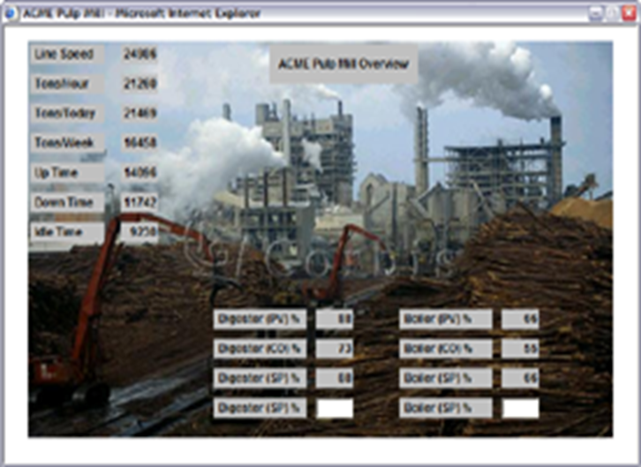
Embedded Web Server
Optional firmware add-on module
Supports live pages in SoftPLC
Pages update in real-time with application data
Develop pages using any HTML editor
Animation/data update can be done with C⁺⁺, PHP, Python & other web technologies
View with any web browser

Slide 34
Embedded Firewall
Optional firmware add-on module
Provides high-end protection and secure remote access
Stateful inspection, NAT/IP masquerading, blacklisting
Multiple VPN tunnels
Ethernet & PPP protection

Slide 35
Hot Standby/Redundancy
Optional firmware add-on module
Comprehensive solution for applications needing 100% uptime
Bumpless transfer of I/O control in case of primary CPU fault
High speed data transfer between primary/secondary controllers on dedicated Ethernet connection
Uses “dumb” arbitrator to assist with switch-over
Status available over network to SCADA/HMI, I/O, TOPDOC, other controllers
With Tealware I/O, fully redundant systems (CPU, I/O, P/S, network)

Slide 36
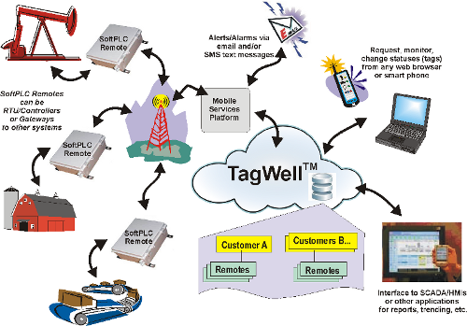
Tagwell
Remote Asset Management Platform

Slide 37
TagWell
A powerful/configurable platform for comprehensive and scalable remote control system management
Utilizes Internet secure cloud technologies and low-cost M2M cellular data communications
User interface is customer specific web pages that can be viewed on any browser
PC
Tablet
Smart Phone

Slide 38
TagWell
Components of a TagWell system can include:
TagWell - Secure Internet based ("cloud") data center
SoftPLC Gateways
Enable remote communication between other vendor's controllers or equipment and TagWell, as well as from TagWell to SCADA systems
Provide immediate alert notification via email or SMS text message
Provide data acquisition and logging functions
SoftPLC RTU's
Industrial controllers that provide I/O monitoring and extensive control, in addition to all the functions of a SoftPLC Gateway

Slide 39
TagWell

Slide 40
TagWell Features/Benefits
Optimized Communications
Remotes can immediately report changes to watched points to TagWell or report based on time interval
Report digital status changes and/or analog changes over user-defined alarm bands
Reporting by exception, minimizes bandwidth requirements
Architecture dynamically grows with demand
No limit on number of remotes
No IT expertise/interaction required for firewalls, VPNs and SIM card management

Slide 41
TagWell Features/Benefits
Intelligent Remotes mean powerful/flexible Asset Mgmt
Include built-in protocols (eg: Modbus, ModbusTCP, and others) to interface w/ common devices (eg: RTU/PLC, flow meters, drives)
Logic functions for I/O control, data concentration & manipulation (eg: averaging, scaling, etc.) and more
Alarm notification via email and/or SMS text messages
Data Logging
Optional embedded web server for local access browser-based operator interface
Optional embedded firewall for layered remote access security and to provide security for local access

Slide 42
Thanks!
http://softplc.com
info@softplc.com

