Slide 1
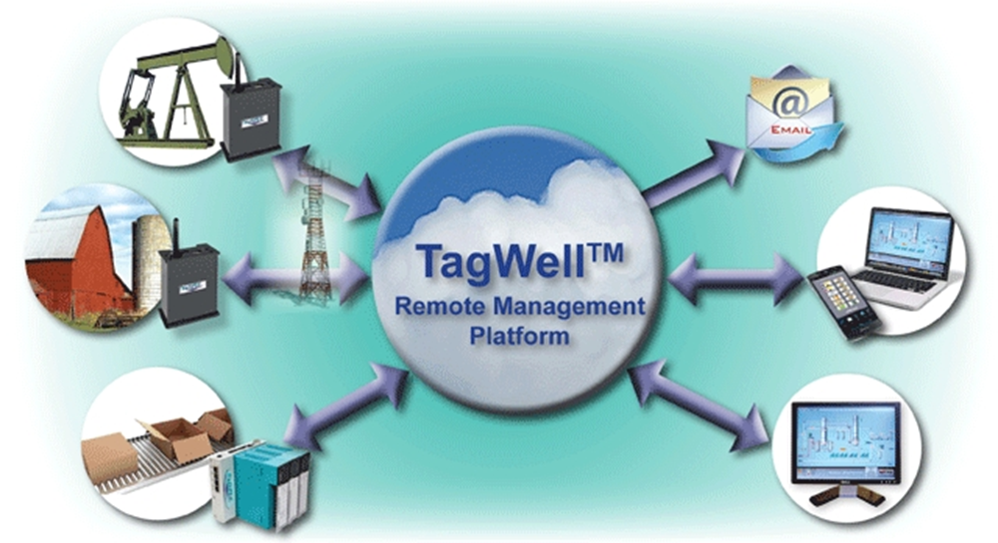
IoT Implementation with Web Studio & TagWell

Slide 2
SoftPLC COrporation
1983
1985
1988
1993
1996
2001
2007
2009
2013
2014
1st Release TOPDOC/SoftWires
Name change to SoftPLC
Tealware I/O released
Linux Version SoftPLC
SoftPLC version of Web Studio
SmartBoard released
TagWell released
Micro SoftPLC released
Tele-Denken formed
1st Release SoftPLC

Slide 3
About SoftPLC Corp.
Founded in 1983 as Tele-Denken Resources, Inc.
Privately held Texas Corporation
US classified as small, woman-owned business
Focused on industrial automation products
Experts in embedded & communications software (e.g.: I/O drivers, networking, operating systems)

Slide 4
SoftPLC Strengths
Inventors & Innovators
Many industry first software features/functions
Embrace & provide open architecture technologies
Apply computer technologies to industrial automation market
Customer driven
Treasure customer feedback
React quickly to customer requests
No support case numbers, direct contact with engineers

Slide 5
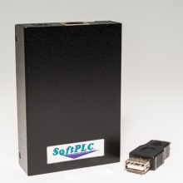
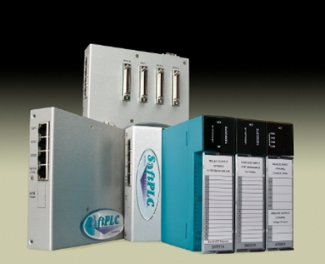
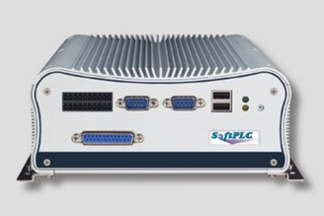
Core SoftPLC Products
SoftPLC® PAC’s (Programmable Automation Controllers)
Range of hardware models
All have same firmware
Gateways (Protocol Converters)
TagWell™ (Remote Management Platform)
Web Studio HMI’s & SCADA software

Slide 6
IoT Implementation with Web Studio & TagWell

Slide 7
Definitions

Slide 8
Definitions
M2M – Machine to Machine
Wireless and wired systems communicating with other devices
IoT – Internet of Things
Internet enabled objects that can network and communicate with each other & with other web-enabled gadgets

Slide 9
Definitions
Cloud
The Internet - a network of servers, clients and routers
Cloud Computing
Application systems which are executed within the cloud
On-demand self-service access/resources
Location independent
Resource allocation elasticity based on demand

Slide 10
Definitions
Cloud Deployment Models
Private – exclusive use by a single organization, on or off premises
Public – provisioned for open use by general public, on premises of cloud provider
Hybrid – combination

Slide 11
Cloud Services
Cloud services include:
Infrastructure (IT resources)
Software applications that run in a thin client/web browser
Software or tools that can be used to create applications
Cloud services are typically subscription products, with fees based on usage

Slide 12
Definitions
Private Subnet
Networked nodes grouped on a common segment with private IP addresses. Examples:
Computers in corporate offices
Cell phones
M2M nodes
Subnet nodes can talk to each other
Private subnet nodes are protected from access by public subnet nodes, unless special techniques are used

Slide 13
Benefits
Economic
Reduces need for capital equipment
Unlimited processing power/storage capability
Built-in redundancy/disaster recovery
Faster project development/deployment
Better Accessibility / Reliability / Security

Slide 14
tagwell

Slide 15
System Components
TagWell - solutions for IoT applications of all sizes, scopes and budgets
TagWell – A public cloud service that provides bi-directional access to/from protected remotes via the internet
SoftPLC Remote – A device that can communicate to TagWell via a private subnet (ie: cellular) or public subnet

Slide 16
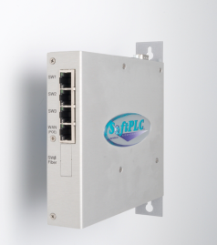
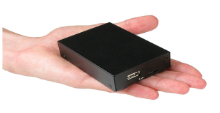
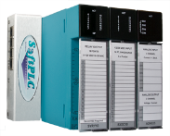
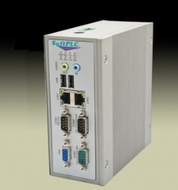
SoftPLC® Remotes
TagWell - solutions for IoT applications of all sizes, scopes and budgets
A SoftPLC® is a low-cost PAC (Programmable Automation Controller)
SoftPLC’s can also be used as multi-protocol capable communication gateways to other control systems or devices
A SoftPLC Remote (eg: RTU) is any SoftPLC connected to TagWell via the Internet

Slide 17
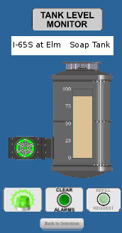
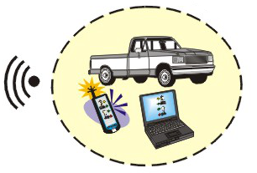
TagWell - solutions for IoT applications of all sizes, scopes and budgets
All SoftPLC’s support features that can eliminate the need for a fixed HMI at the remote location
Embedded web server, email/text alarming, embedded firewall…
Saves equipment cost, eliminates hardware maintenance
“Drive-by” browser-based operator interfaces are possible (eg: using Wi-Fi or Bluetooth)

Slide 18
TagWell - solutions for IoT applications of all sizes, scopes and budgets
TagWell™ provides:
A secure bi-directional access path to “things” over the Internet
An API that can be used to develop browser and web-based applications
A cache for user-selected “interesting” data from Remotes
TagWell optimizes data plans to reduce cost

Slide 19
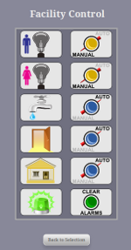
TagWell - solutions for IoT applications of all sizes, scopes and budgets
TagWell has an SMTP server that SoftPLC Remotes can use to send email or text messages (eg: alarms, status or production reports)
TagWell data can be accessed via password protected http
A web browser can be used for user interface
Web Studio via the TagWell driver
User applications written using the TagWell API can communicate to databases, generate reports, and more
SoftPLC Corp can host these custom applications in the cloud

Slide 20
TagWell - solutions for IoT applications of all sizes, scopes and budgets
TagWell provides inexpensive bi-directional access to remote assets from anywhere over the Internet
TagWell’s design includes features that maximize delivery reliability and minimize communication costs
Intelligent SoftPLC Remotes further minimize communication costs by sending data to TagWell only upon user-determined events and/or on a user-determined schedule

Slide 21
Web studio + Tagwell

Slide 22
Web Studio + TagWell
Web Studio’s TagWell driver provides read/write access to SoftPLC Remotes on a private subnet
Each Remote and its Tags are separately accessible via Driver Worksheets
Using TagWell API and Web Studio scripting, additional functions possible (eg: file transfers)

Slide 23
Web Studio + TagWell
TagWell - solutions for IoT applications of all sizes, scopes and budgets
SCADA application benefits
User customizable applications (vs. fixed/limited dashboards of many other cloud solutions)
No limits – all Web Studio functions available
Communication benefits
Reduced cost (Application design should consider impact of “writes”)
Increased data update/throughput rates

Slide 24
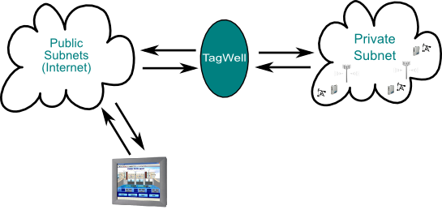
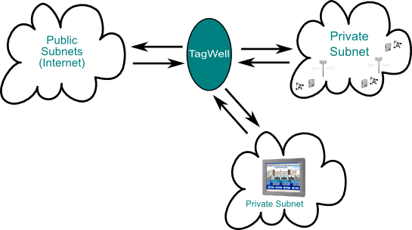
Configurations
TagWell - solutions for IoT applications of all sizes, scopes and budgets

Slide 25
Cloud-based Web Studio
TagWell - solutions for IoT applications of all sizes, scopes and budgets
Running Web Studio in the cloud
Allows secure remote access to Web Studio applications
Provides cloud-based infrastructure benefits
SoftPLC Corp. can host installation

Slide 26
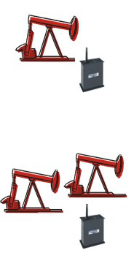
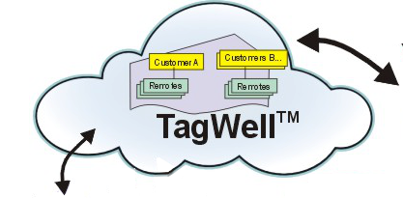
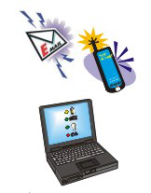
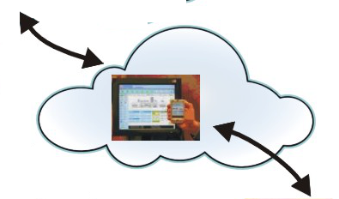
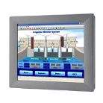
TagWell - solutions for IoT applications of all sizes, scopes and budgets
Application Example

Slide 27
An Optimal Solution
TagWell - solutions for IoT applications of all sizes, scopes and budgets
SoftPLC, TagWell and Web Studio make IoT low cost & nearly effortless
Low cost, flexible, powerful Remotes
Optimized remote communications
Meet your remote control & monitoring, data logging & asset management for applications of all sizes and scopes!

Slide 28
For more info….
http://softplc.com
info@softplc.com
1-800-SoftPLC or 512-264-8390

